Slide 1
Corporate Purchasing Card
Enhanced Reporting
January 2015
Web Version

Slide 2
Agenda
Background
AccessOnline
Level 3 Data
Declined Transaction Review
Multiple Vendors at One Address
Employee Address and Vendor Address are the Same
High Dollar Volume of Purchases by One Cardholder from an Obscure Vendor
Purchases Structured to Avoid Transaction Limits

Slide 3
Background
2014 OLA Performance Audit highlighted some significant cardholder misuse
CPC Program has:
Established roles and responsibilities
Separation of duties
Policies and controls in place to detect fraud, waste and abuse, IF FOLLOWED
Notes:
Fraud – unauthorized use of the P-card normally by a third-party
Misuse – unauthorized activity by a cardholder, usually where the cardholder profits from the transactions
Report dated March 2014

Slide 4
Background
Key CPC personnel:
Bank Customer Service and Fraud Staff
CPC Steering Committee
GAD CPC staff
Agency Fiscal Officers and Agency PCPAs
Authorized Reviewers, Supervisors, Internal Auditors and OLA
Cardholders
Merchants
Notes:
Bank Customer Service and Fraud staff – have controls and monitoring to detect fraud
CPC Steering Committee – decide policy issues concerning CPC
GAD CPC staff – interpret and enforce policies, act as liaison between the State agencies and the Bank
Agency Fiscal officers and Agency PCPAs – control spending and insure compliance with State regulations
Authorized Reviewers, Supervisors, Internal Auditors, and OLA – all are checking to insure that transactions are legitimate and necessary for State business
Cardholders verify statements to insure that transactions are legitimate and card has not been compromised
Merchants – provide reasonably priced good and services to State agencies, accurately bill for same
As a result of the 2014 OLA performance Audit GAD was required to:
Revise the CPC Program Policy and Procedures Manual
Require the use of Level-3 reporting by the State agencies
Revise the monthly Agency Certification form
Provide training on enhanced reporting options

Slide 5
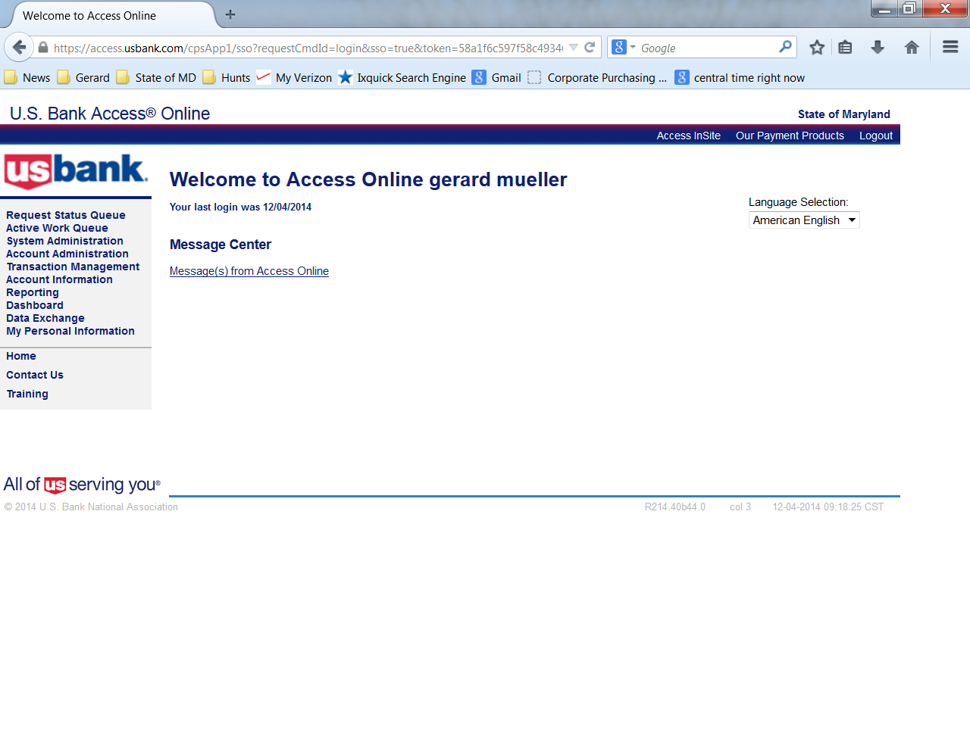
AccessOnline
Sign onto AccessOnline

Slide 6
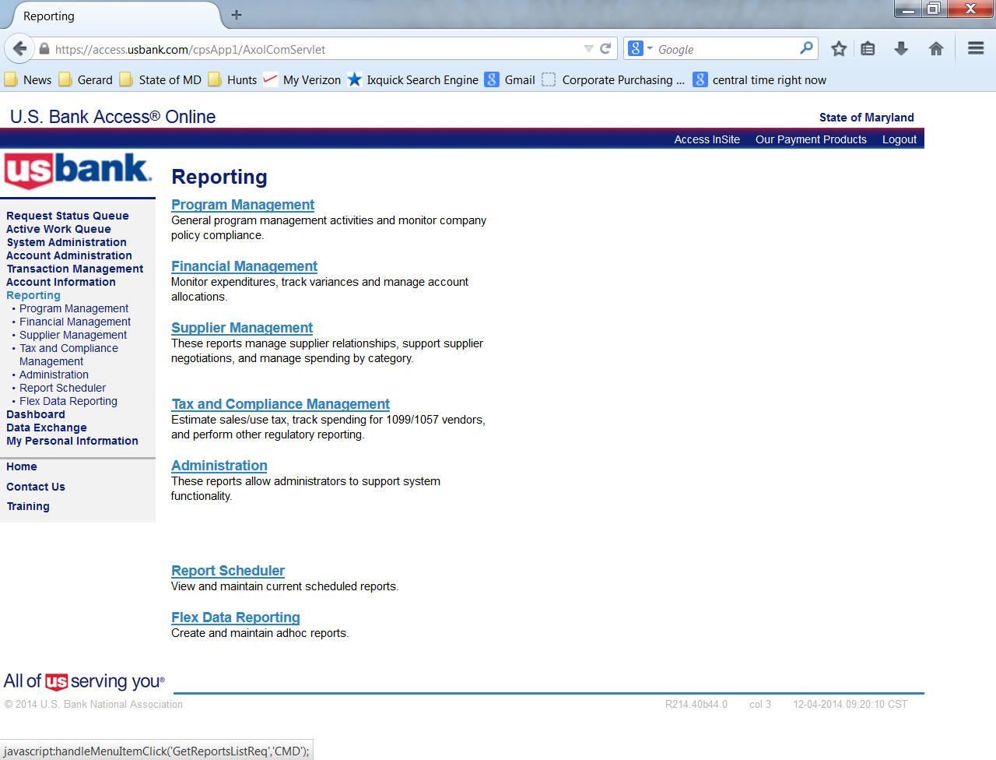
AccessOnline
Select Reporting

Slide 7
Level 3 Data
Merchant Spend Analysis by Line Item

Slide 8
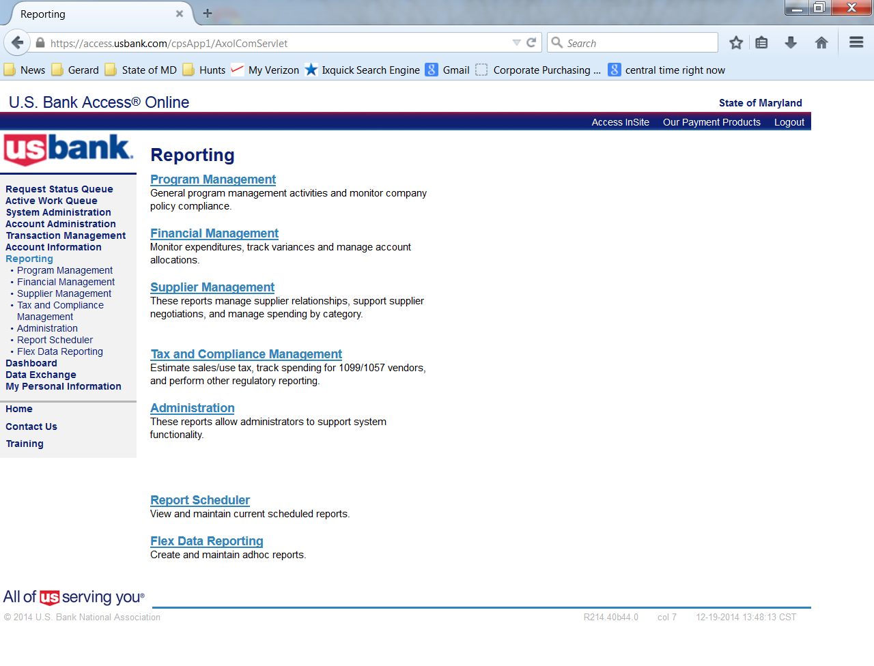
Merchant Spend Analysis by Line Item (Level 3 Data)
Select Supplier Management

Slide 9
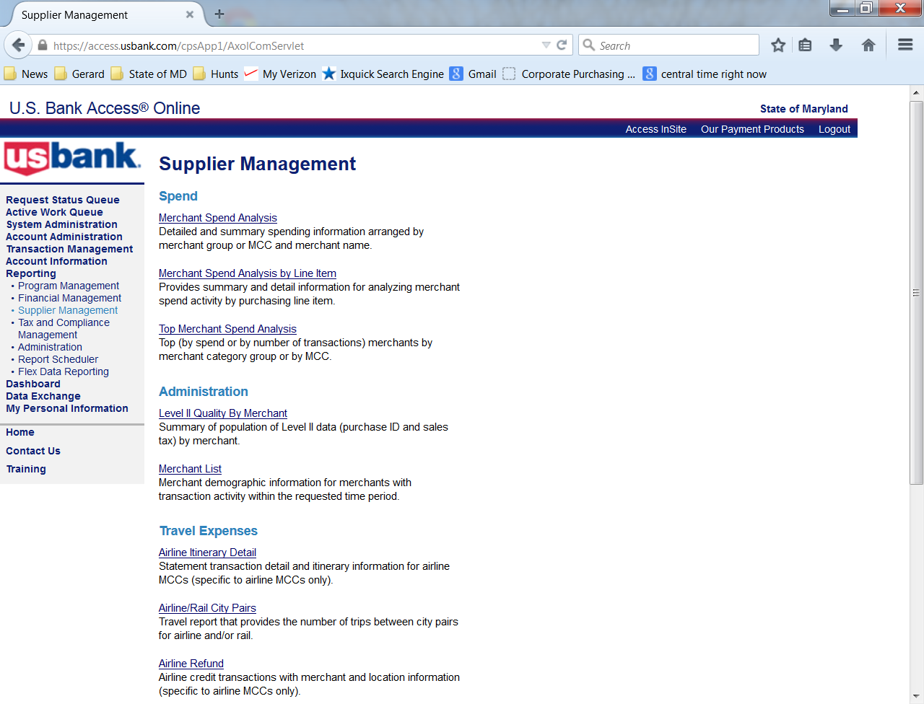
Merchant Spend Analysis by Line Item (Level 3 Data)
Select Merchant Spend Analysis by Line Item

Slide 10
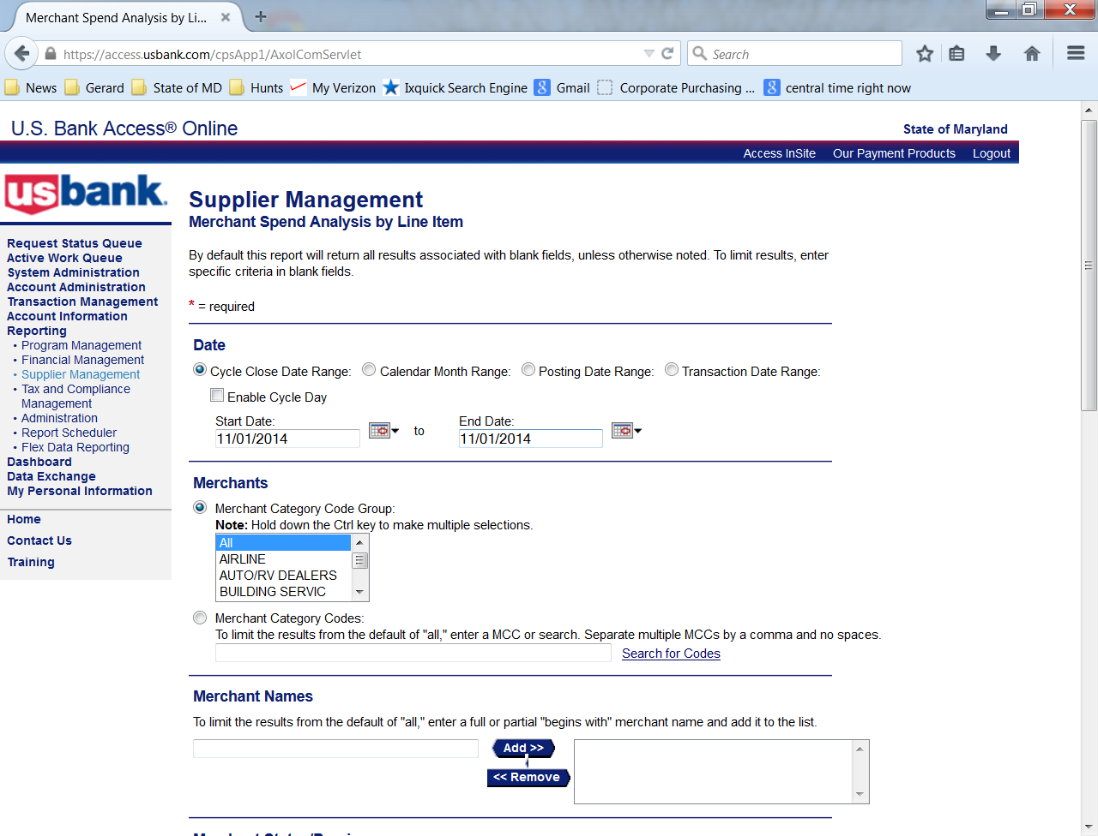
Merchant Spend Analysis by Line Item (Level 3 Data)
Select date range
Notes:
Entering the date as 11/1/2014 will pull the cycle file for November 2014

Slide 11
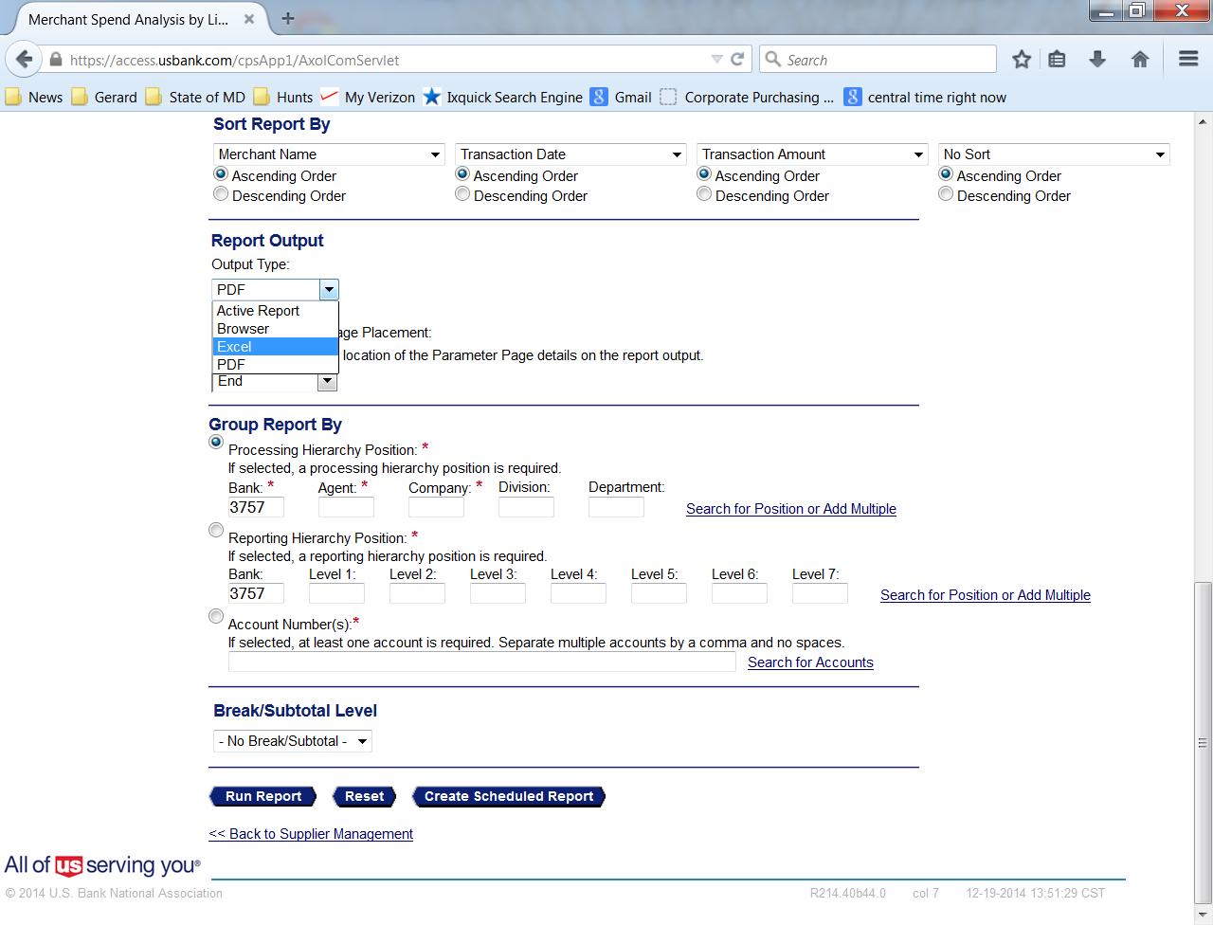
Merchant Spend Analysis by Line Item (Level 3 Data)
Select Excel
Notes:
Report output choose Excel

Slide 12
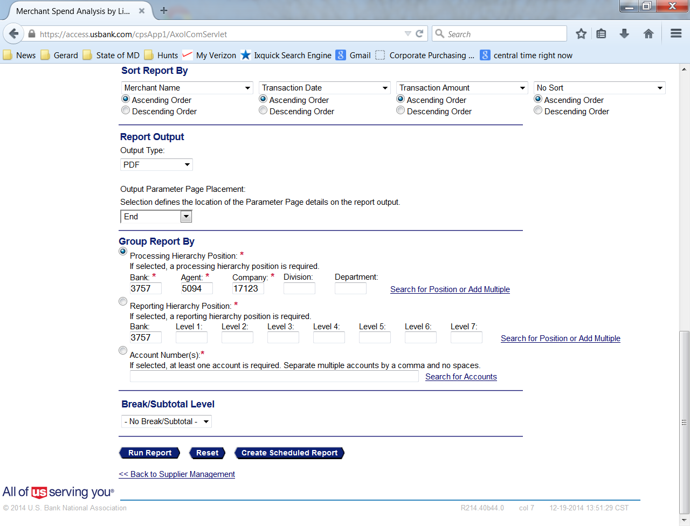
Merchant Spend Analysis by Line Item (Level 3 Data)
Enter Agent and Company numbers
Select Run Report
Select Run Report

Slide 13
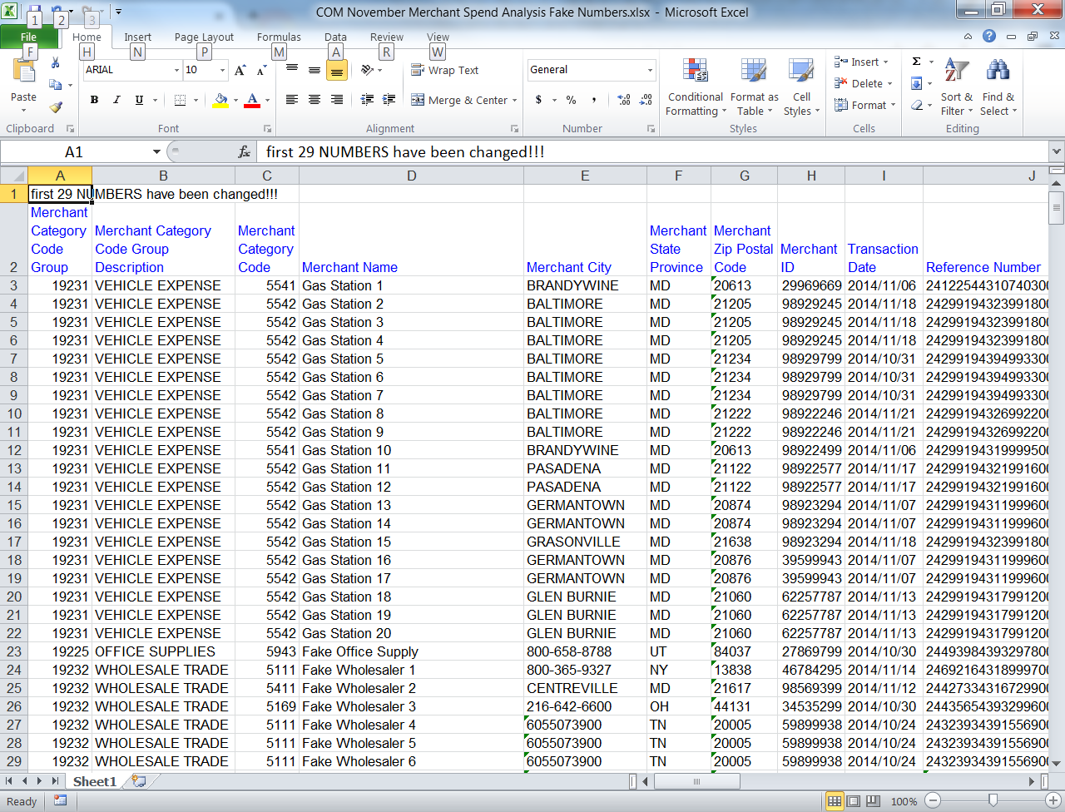
Merchant Spend Analysis by Line Item (Level 3 Data)
Save file to excel

Slide 14
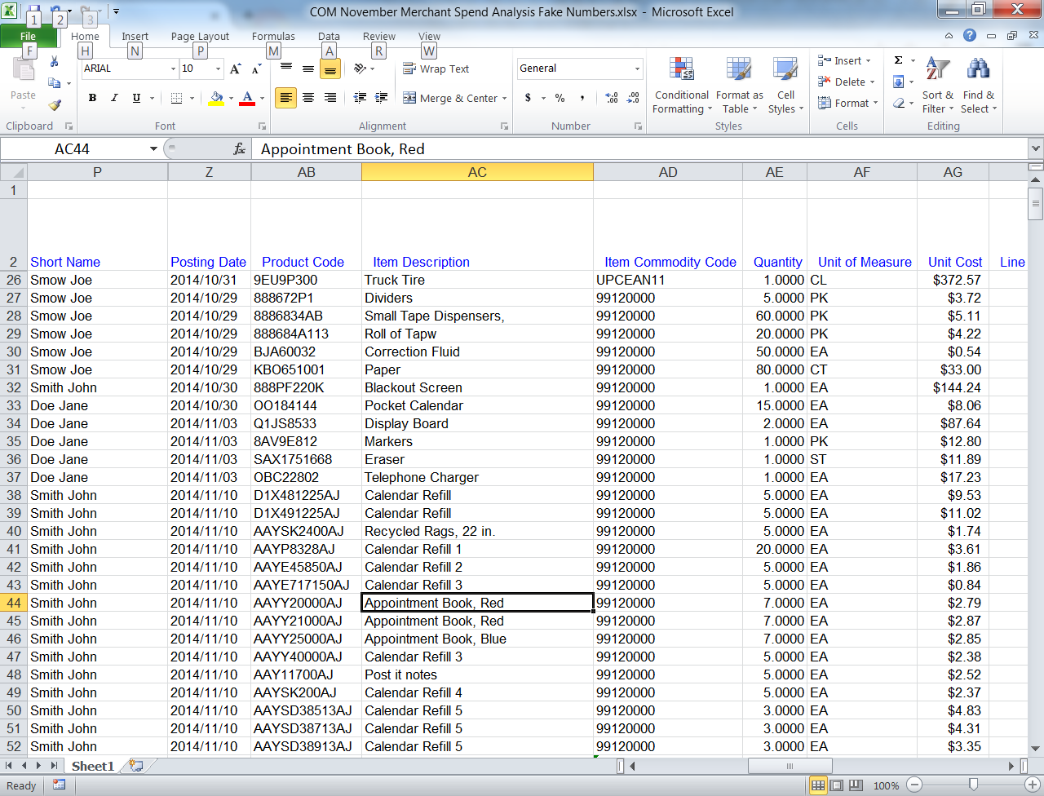
Merchant Spend Analysis by Line Item (Level 3 Data)
Scroll Right & review Item Description column
Notes:
Scroll Right and hide unnecessary columns
Look at the Item Description Column
Ensure what was purchased matches what the cardholder writes on the Cardholder Log

Slide 15
Merchant Spend Analysis by Line Item (Level 3 Data)
Remember that level 3 data is provided by approximately 40% of US merchants
Non-level 3 transactions should also be reviewed
Remind the cardholders that detailed item description is available from VISA
Let them know you are reviewing these reports

Slide 16
Declined Transaction Review
Declined Transaction Report

Slide 17
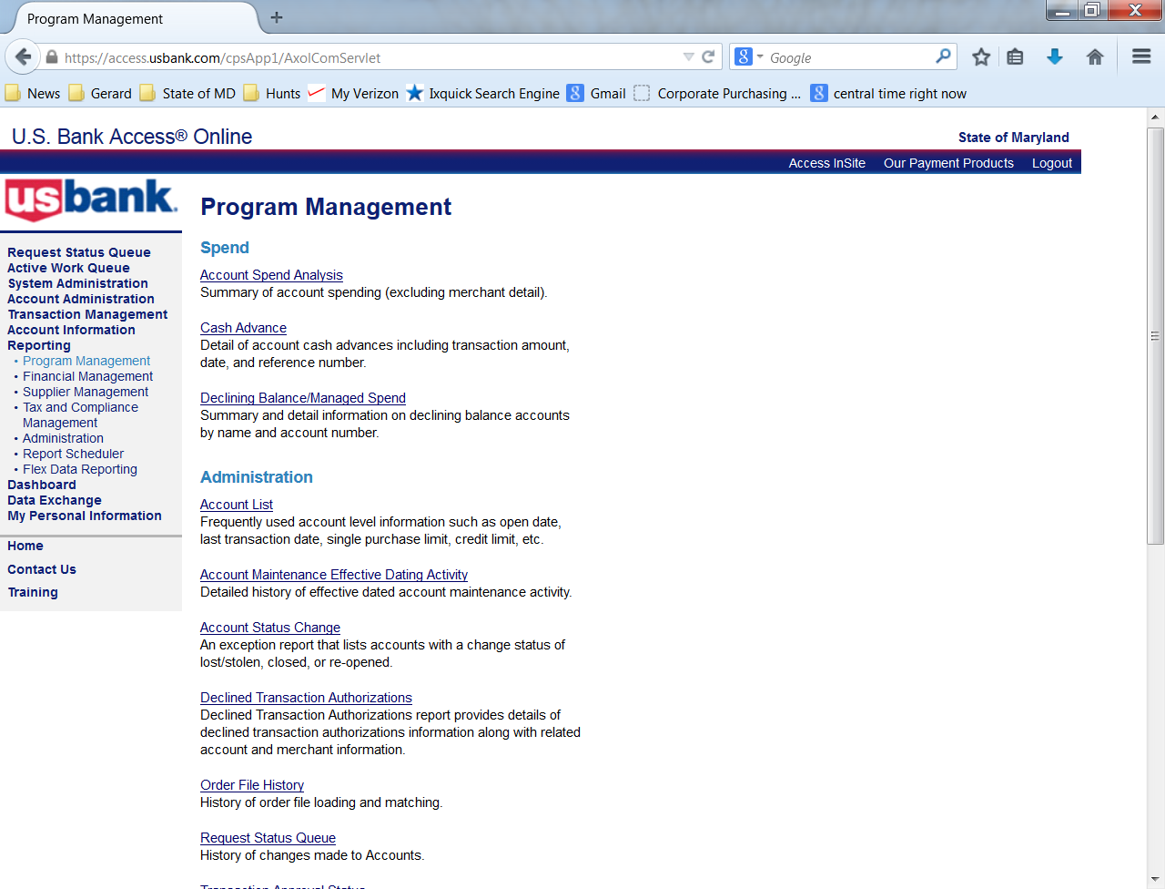
Declined Transaction Report
Select Program Management

Slide 18
Declined Transaction Report
Select Declined Transaction Authorizations

Slide 19
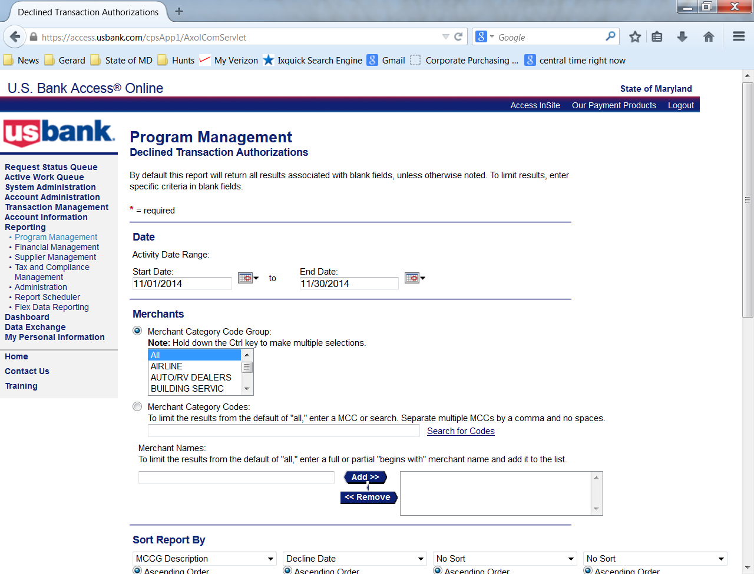
Declined Transaction Report
Select the date range
Notes:
Date range 11/01/2014 to 11/01/2014 will pull the cycle date for November’s transactions.

Slide 20
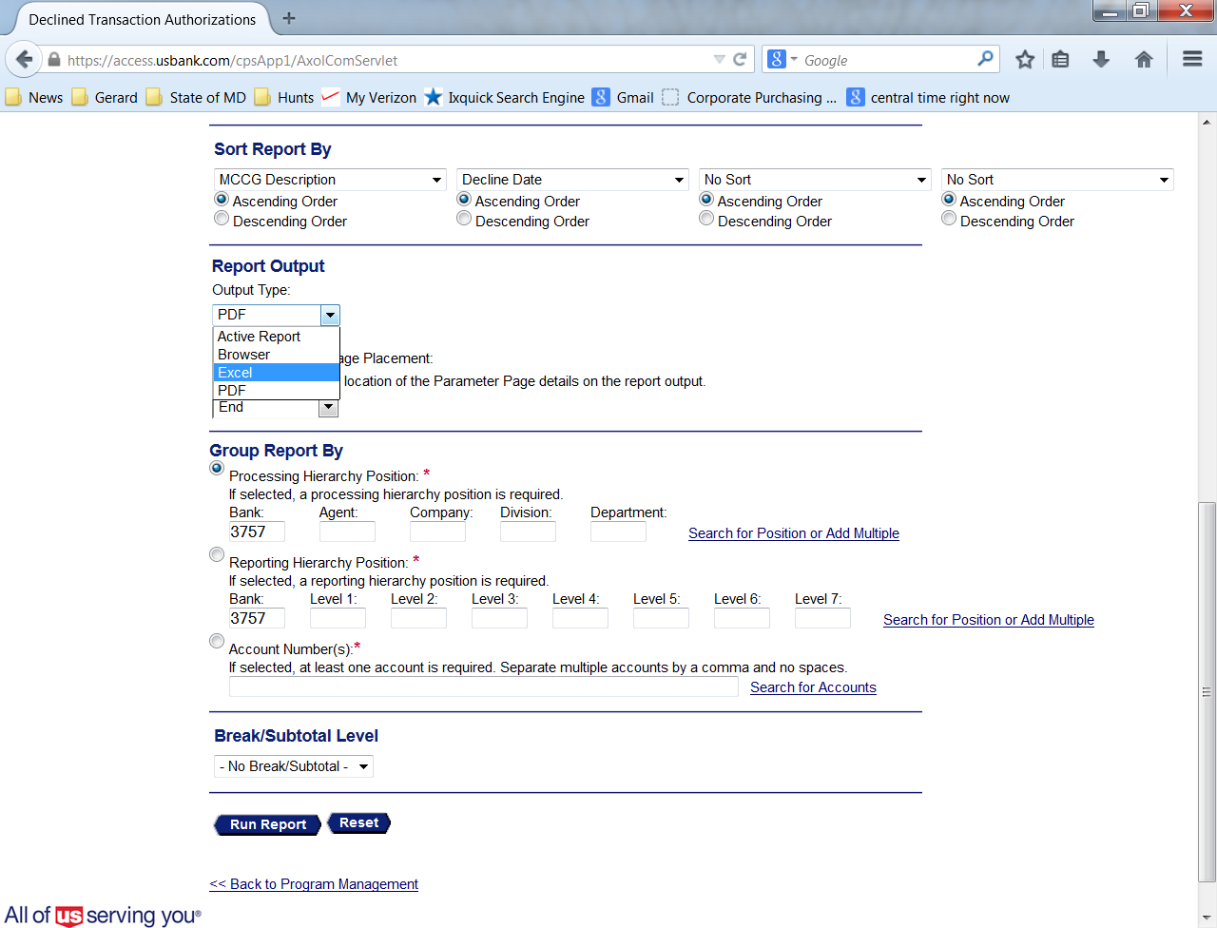
Declined Transaction Report
For Report Output Select Excel

Slide 21
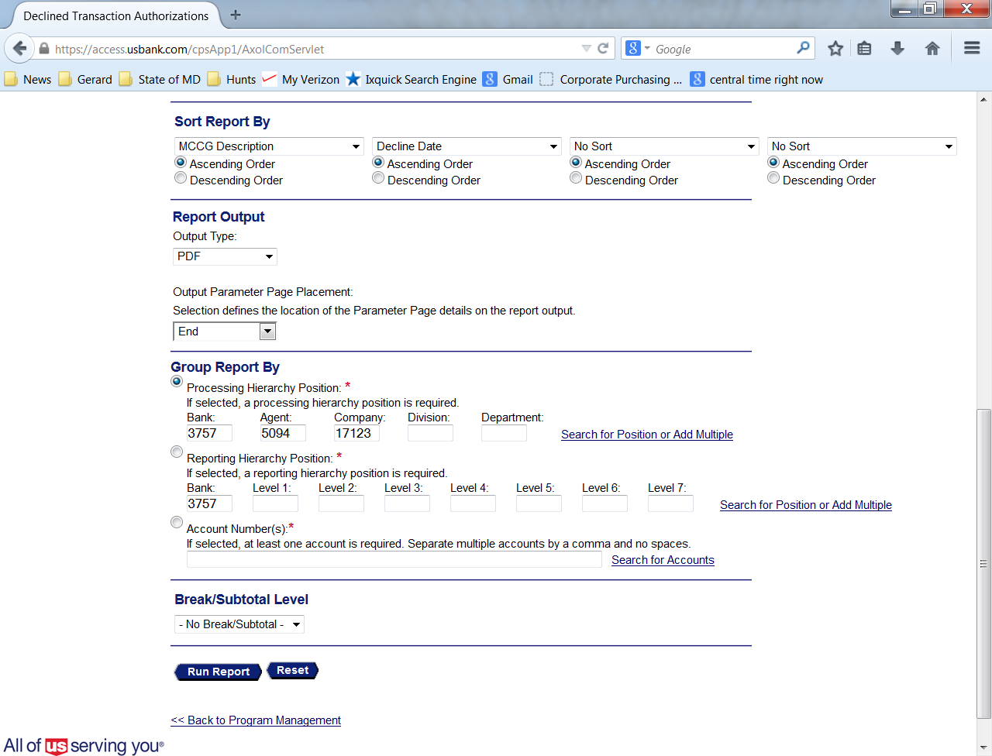
Declined Transaction Report
Enter the Agent and Company numbers
Select Run report

Slide 22
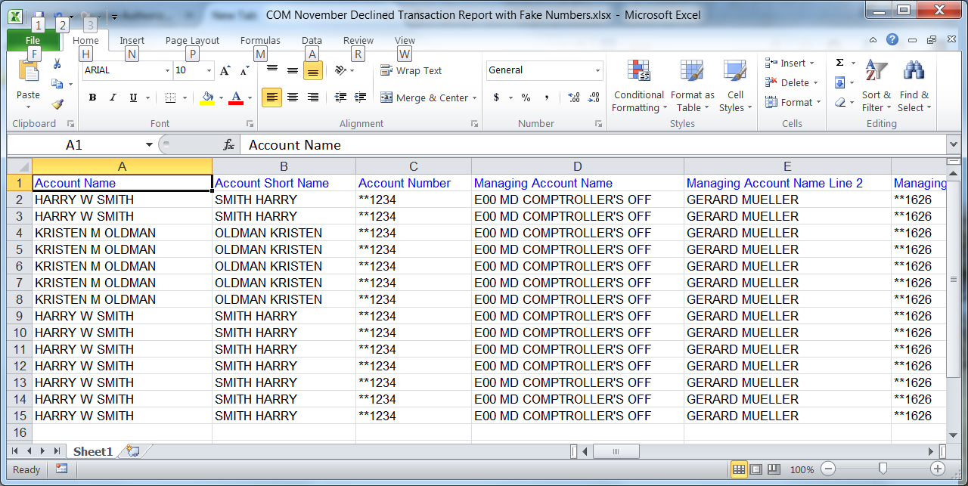
Declined Transaction Report
Save the Excel file to your hard drive

Slide 23
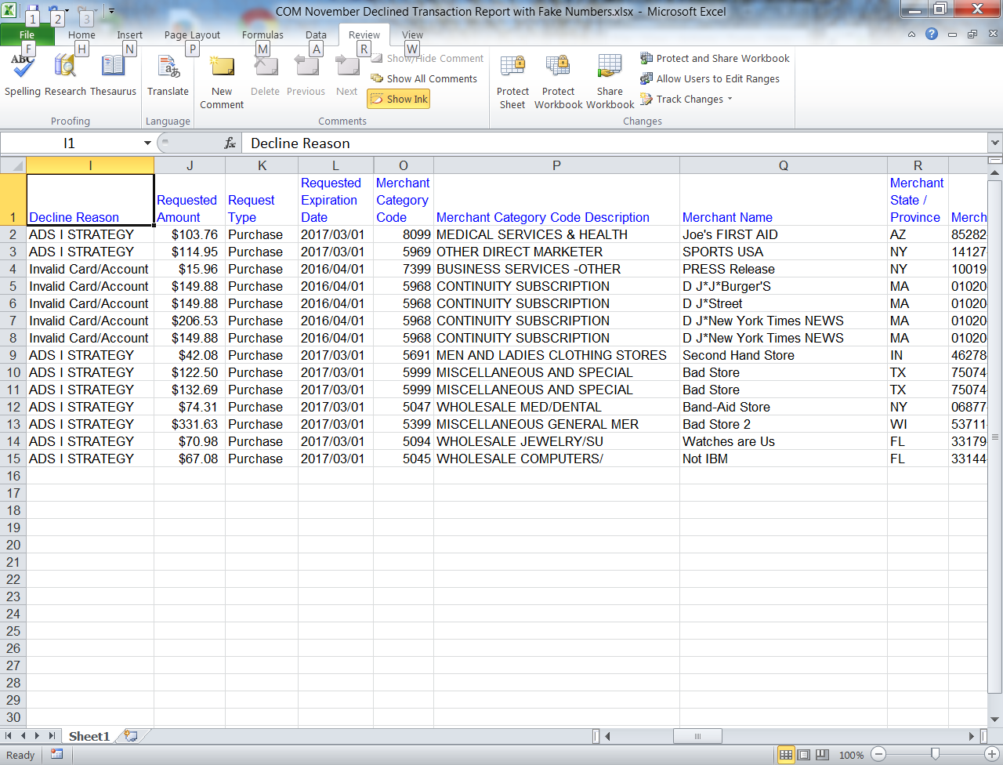
Declined Transaction Report
Scroll to the right to determine reason

Slide 24
Declined Transaction Report
Attempts in excess of the Single Purchase limit, Monthly Credit limit, or a blocked vendor could indicate a cardholder training issue or an attempt at misuse.
Use this report to determine patterns of potential abuse.
Notes:
Attempts on the weekend at casinos or hotels also indicate problems.
Note that the VISA network has many redundant reports. If a cardholder tries a transaction – it will be documented.
Fraud attempts have been discovered while using this report.
Report those cards to USbank as Lost or Stolen

Slide 25
Multiple Vendors at One Address
Supplier Management Report

Slide 26
Multiple Vendors at One Address
Select Supplier Management

Slide 27
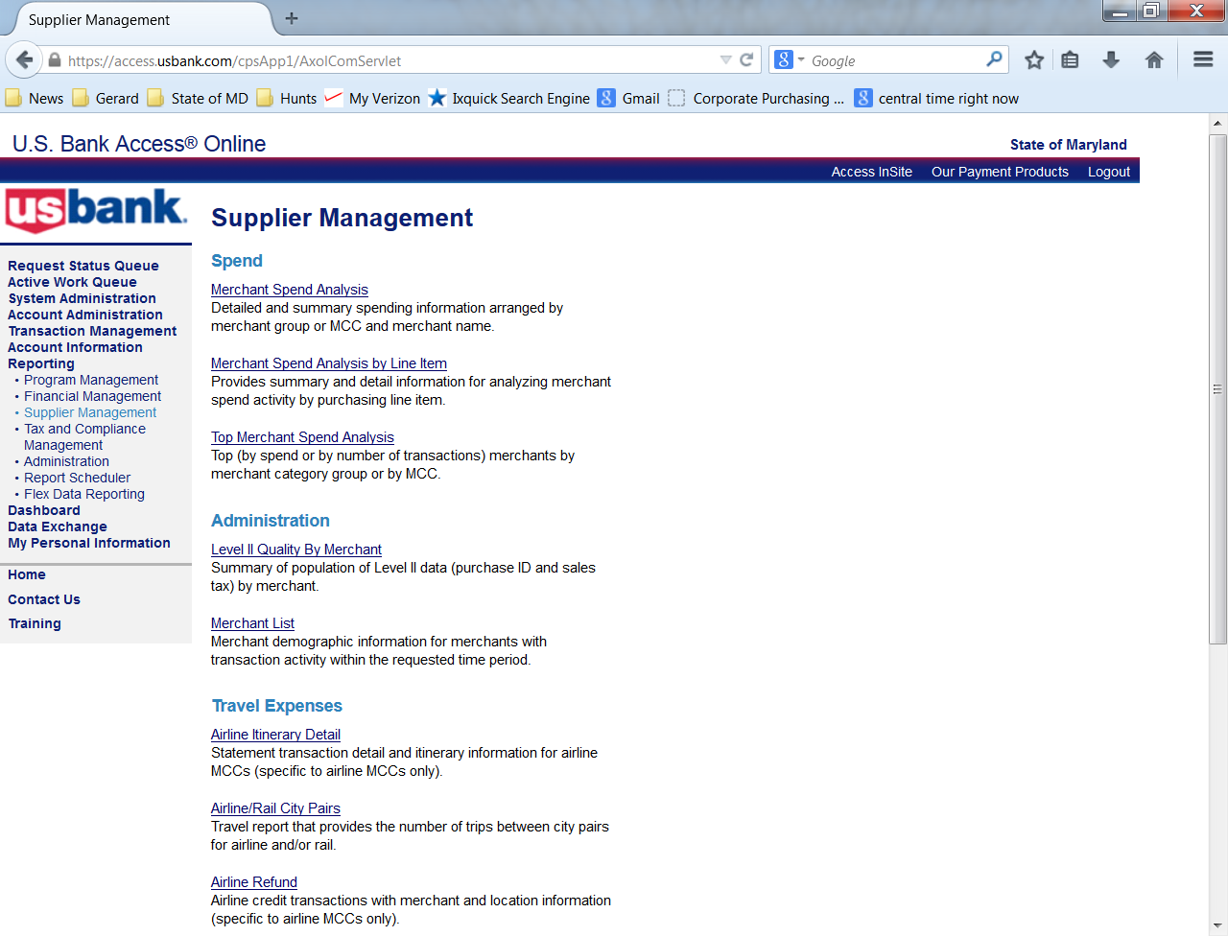
Multiple Vendors at One Address
Select Merchant List

Slide 28
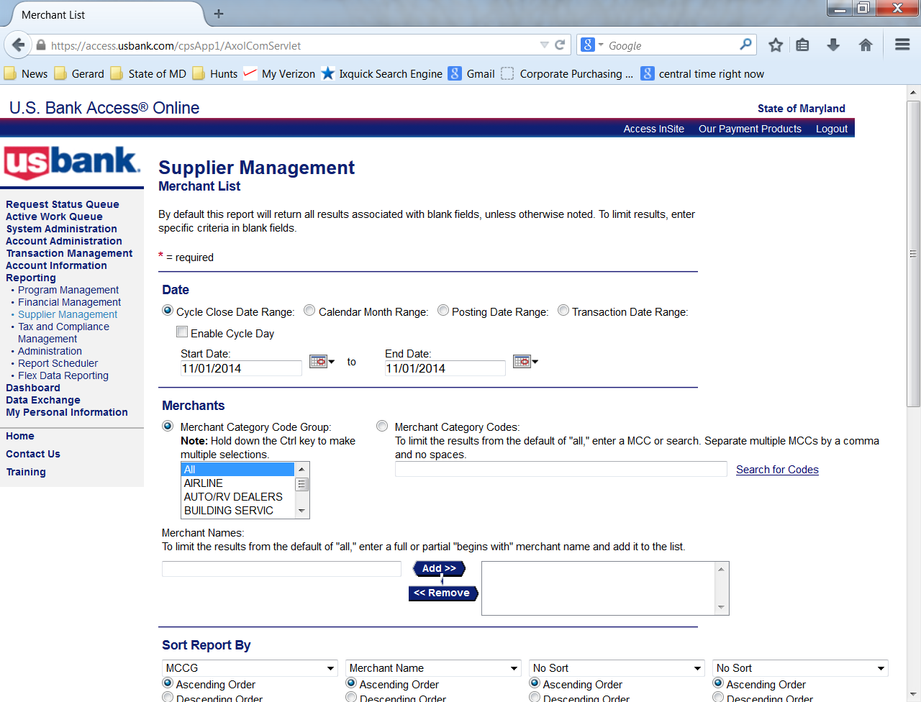
Multiple Vendors at One Address
Select date range

Slide 29
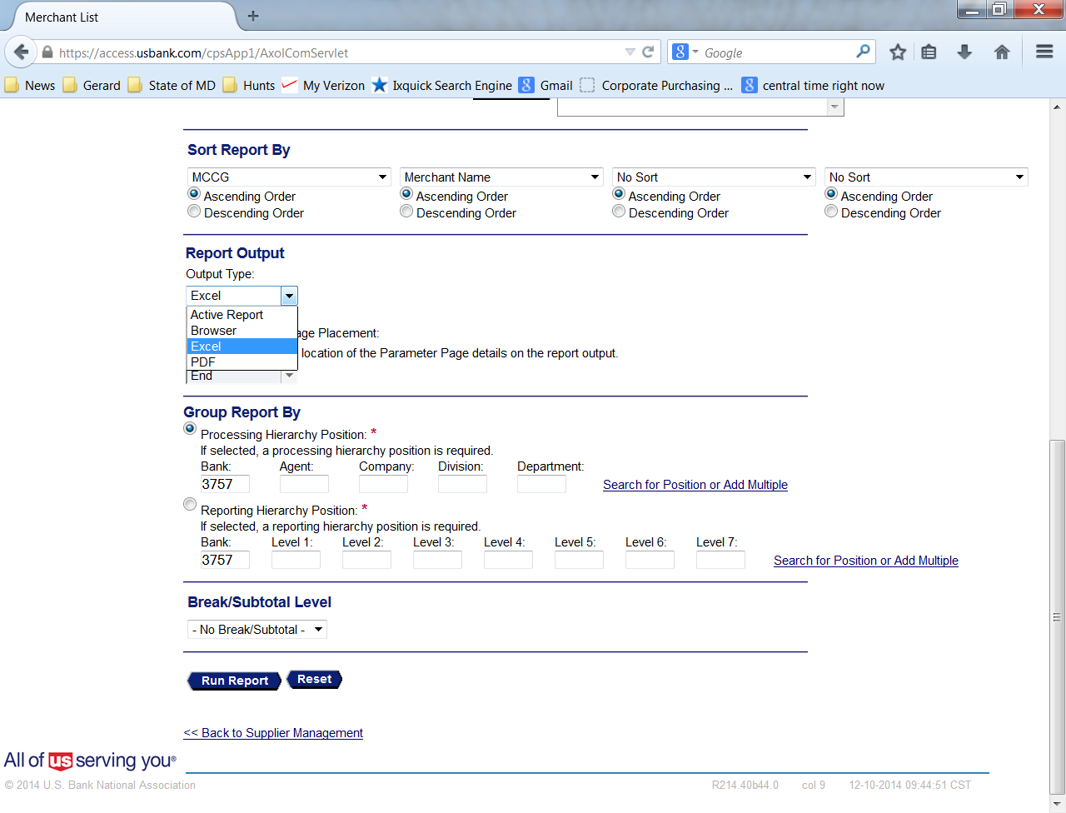
Multiple Vendors at One Address
Select Excel

Slide 30
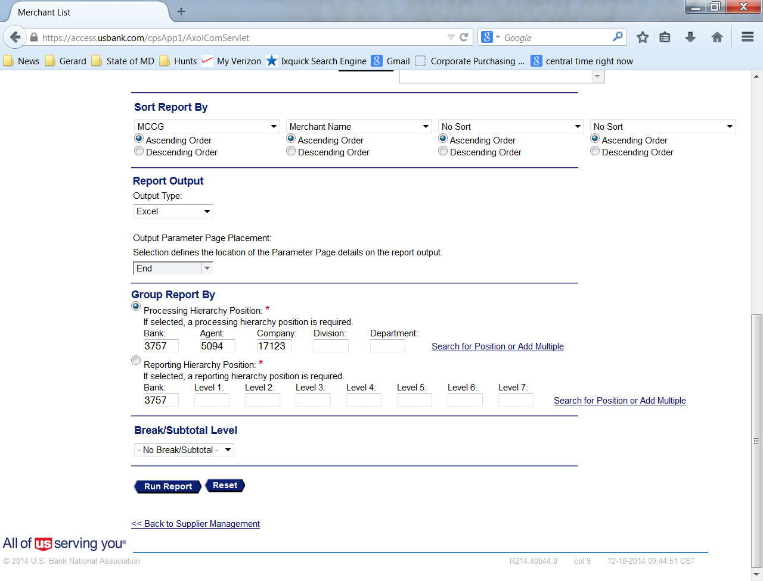
Multiple Vendors at One Address
Enter the Agent and Company numbers
Select Run Report

Slide 31
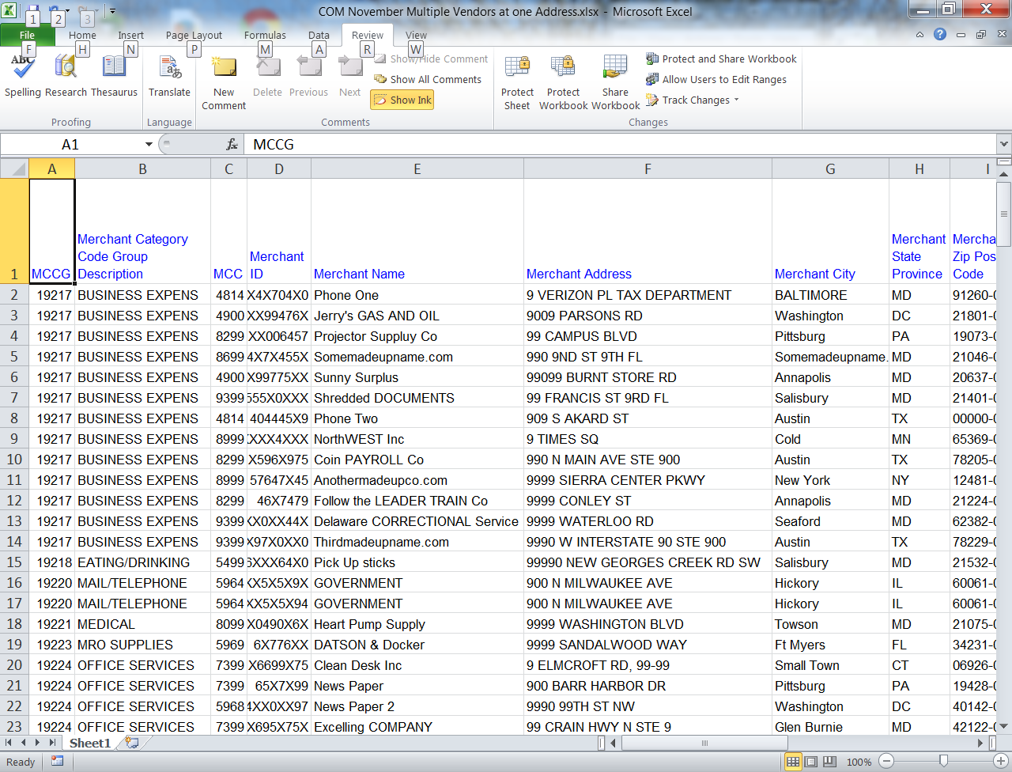
Multiple Vendors at One Address
Save the Excel file to your hard drive
Notes:
Save the Excel file to your hard drive
You will use this report for the Employee Address / Vendor Address are same
match.

Slide 32
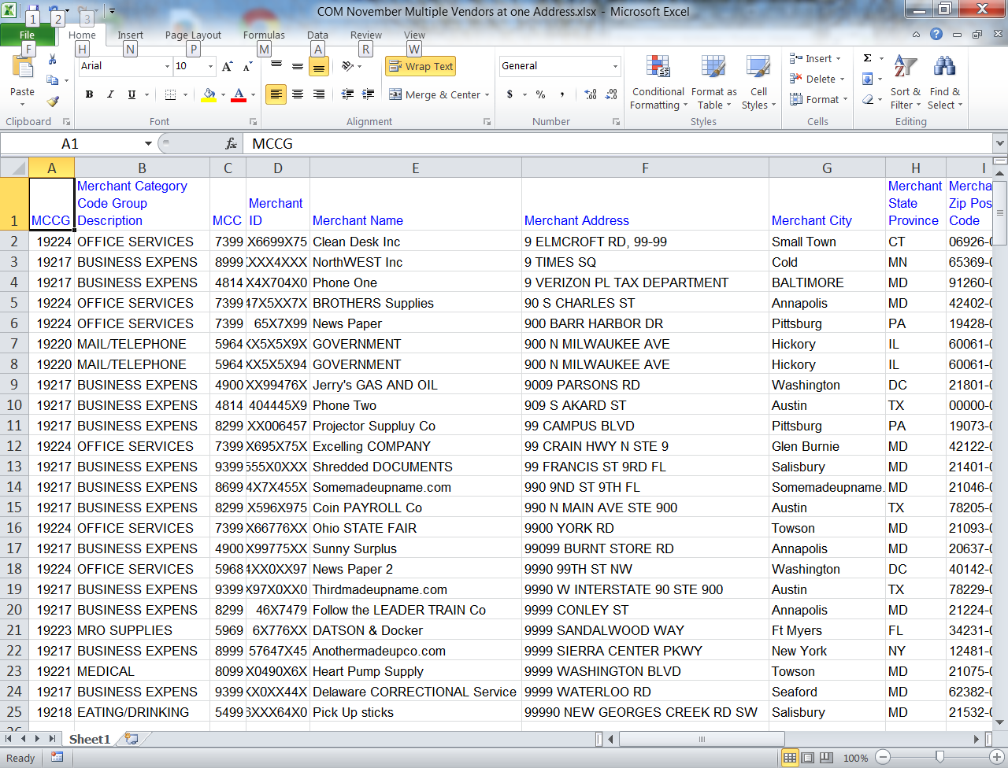
Multiple Vendors at One Address
Sort the document by address

Slide 33
Multiple Vendors at One Address
Determine if more that one merchant is using the same address.
If so, is the business legitimate?
Search the Internet for information
Determine products being sold
Determine if the business is registered with the Secretary of State
Determine if vendor is on a State wide contract
Notes:
Determine if the business is registered with the Maryland Department of Assessment and Taxation or other state’s Secretary of State

Slide 34
Multiple Vendors at One Address
Search the address on the internet
Google Maps has a street view of most addresses
Does the item purchased fit with the location of the vendor (for example: industrial equipment being purchased from a residential house)
Follow-up as necessary

Slide 35
Employee Address and Vendor Address are the Same
Supplier Management Report
&
List of employee names and addresses from Human Resources

Slide 36
Employee Address and Vendor Address are the Same
Source: Merchant List previously saved

Slide 37
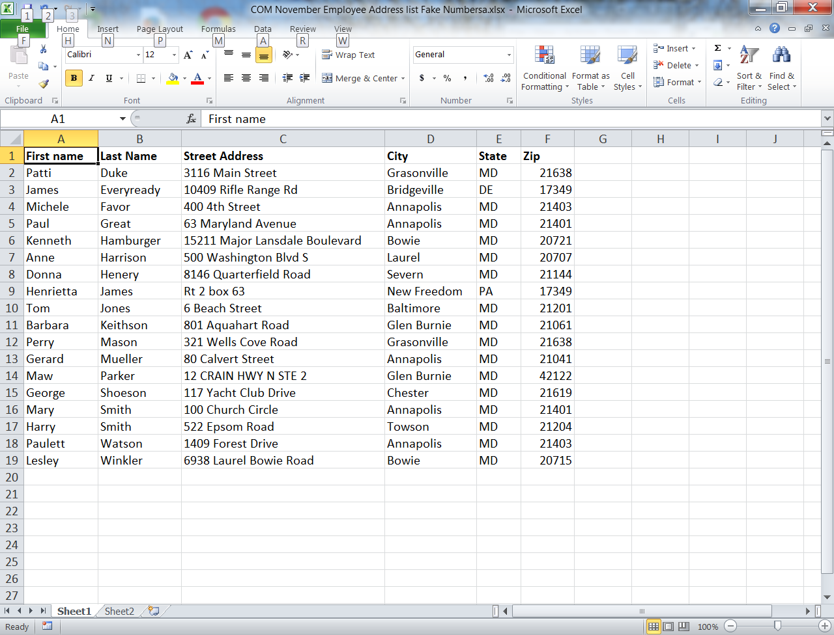
Employee Address and Vendor Address are the Same
Employee file from Human Resources

Slide 38
Employee Address and Vendor Address are the Same
Use the Merchant List file
Obtain a list of employee names and addresses from HR
Sort both by the address
Notes:
Use the Merchant List file previously run

Slide 39
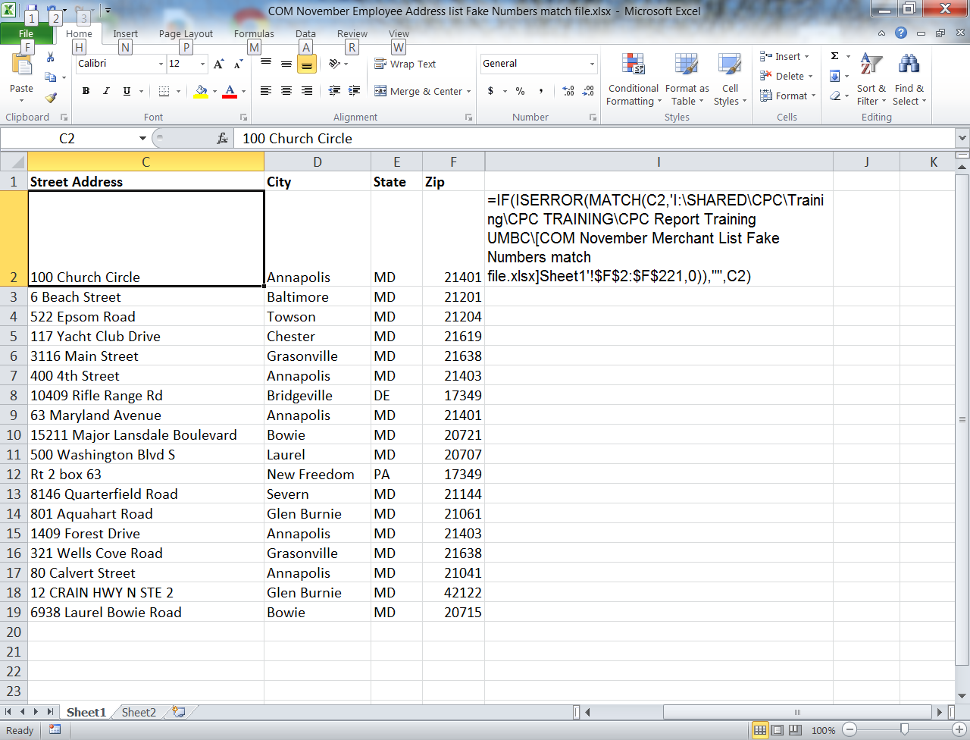
Employee Address and Vendor Address are the Same
Displaying the excel match formula
Notes:
Using excel function or visually, match any addresses that are the same
Displaying the excel match formula in column I
Formula tab or the at look up feature; if item in column a is the same as the item in column b then show match
Contact GAD if you have particular questions

Slide 40
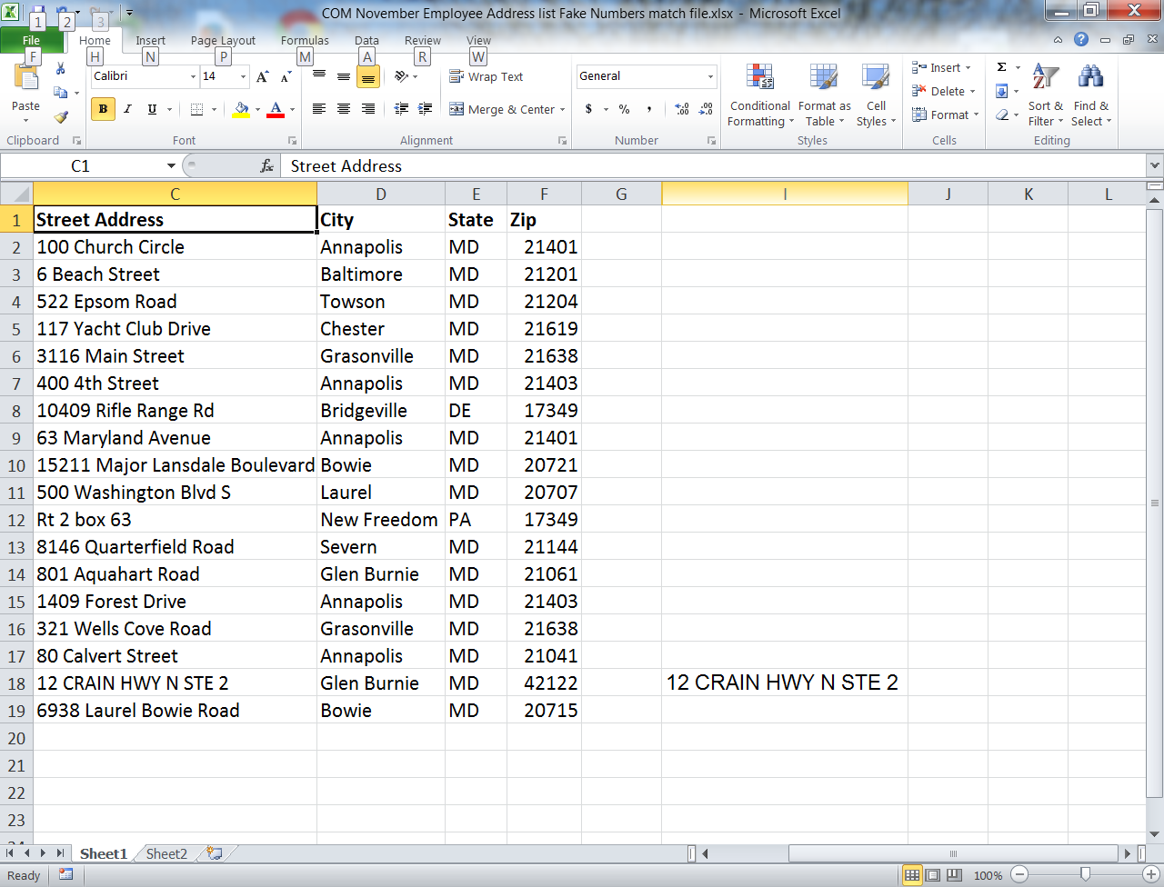
Employee Address and Vendor Address are the Same
Results

Slide 41
Employee Address and Vendor Address are the Same
Using excel function or visually, match any addresses that are the same
Investigate if you find a match
Notes:
See separate handout
If you find a match, investigate further to determine if legitimate service is being provided

Slide 42
High Dollar Volume of Purchase by One Cardholder from an Obscure Vendor
Transaction Detail Report

Slide 43
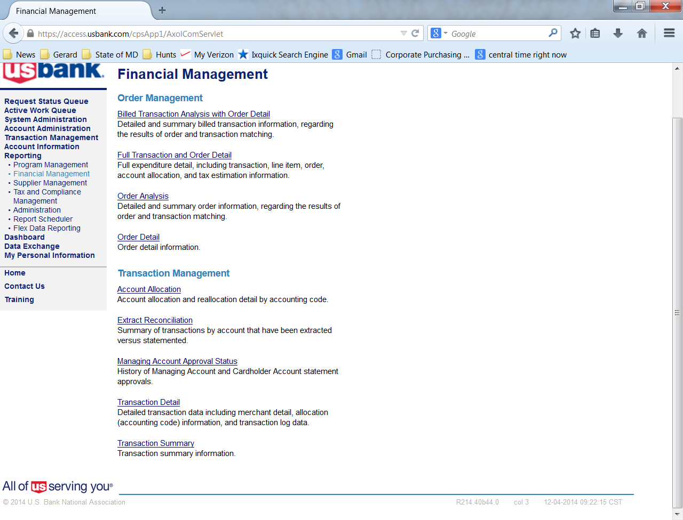
High Dollar Volume of Purchase by One Cardholder from an Obscure Vendor Transaction Detail Report
Select Financial Management

Slide 44
High Dollar Volume of Purchase by One Cardholder from an Obscure Vendor Transaction Detail Report
Select Transaction Detail

Slide 45
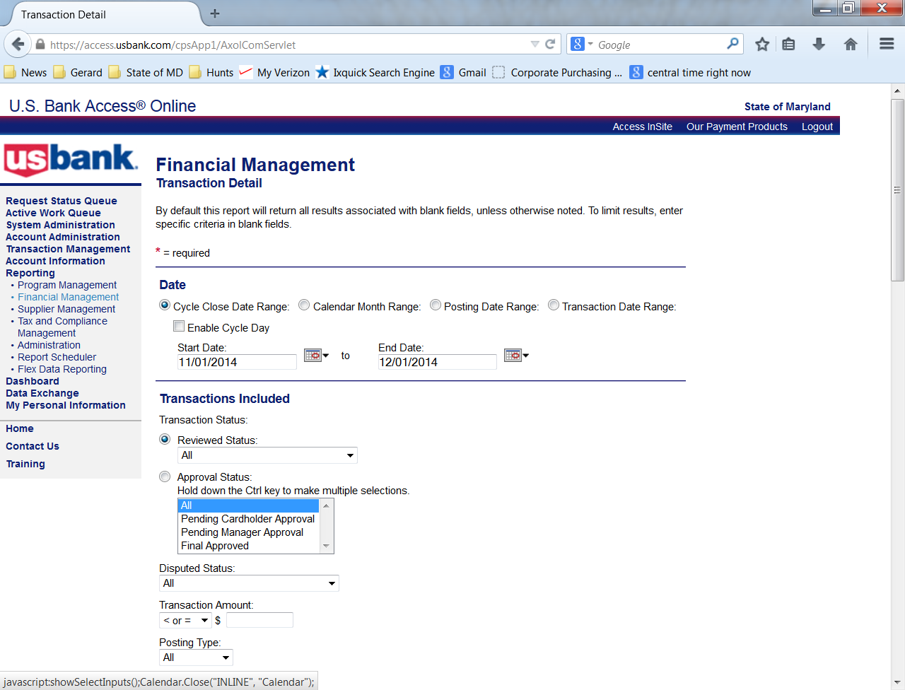
High Dollar Volume of Purchase by One Cardholder from an Obscure Vendor Transaction Detail Report
Select the date range

Slide 46
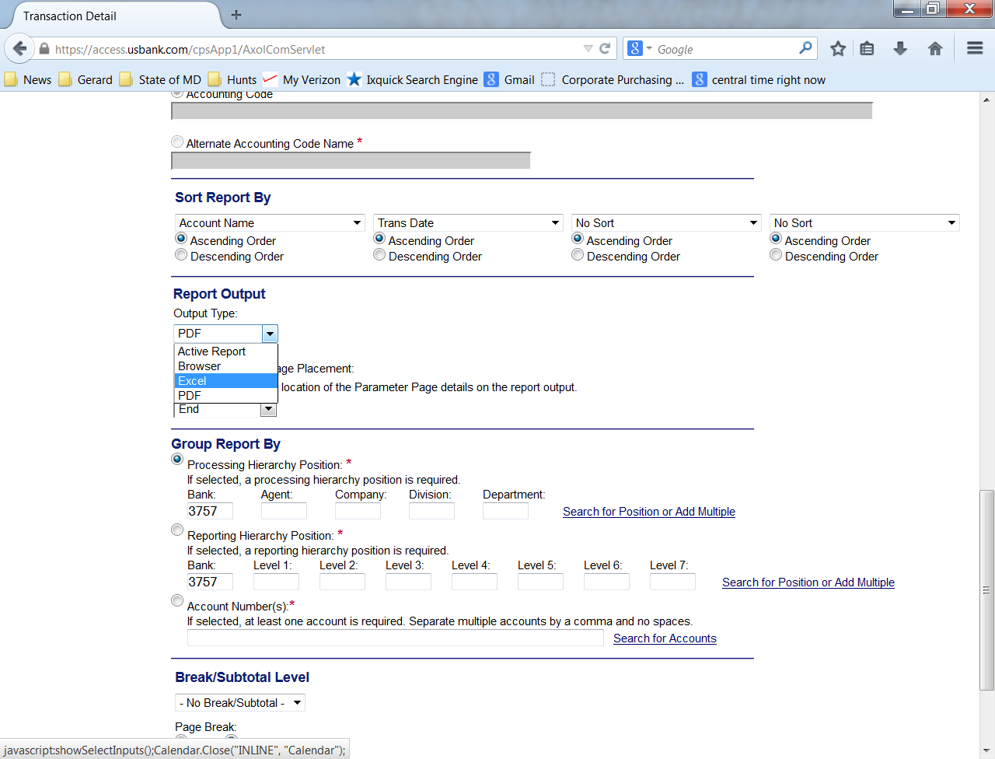
High Dollar Volume of Purchase by One Cardholder from an Obscure Vendor Transaction Detail Report
Select Excel

Slide 47
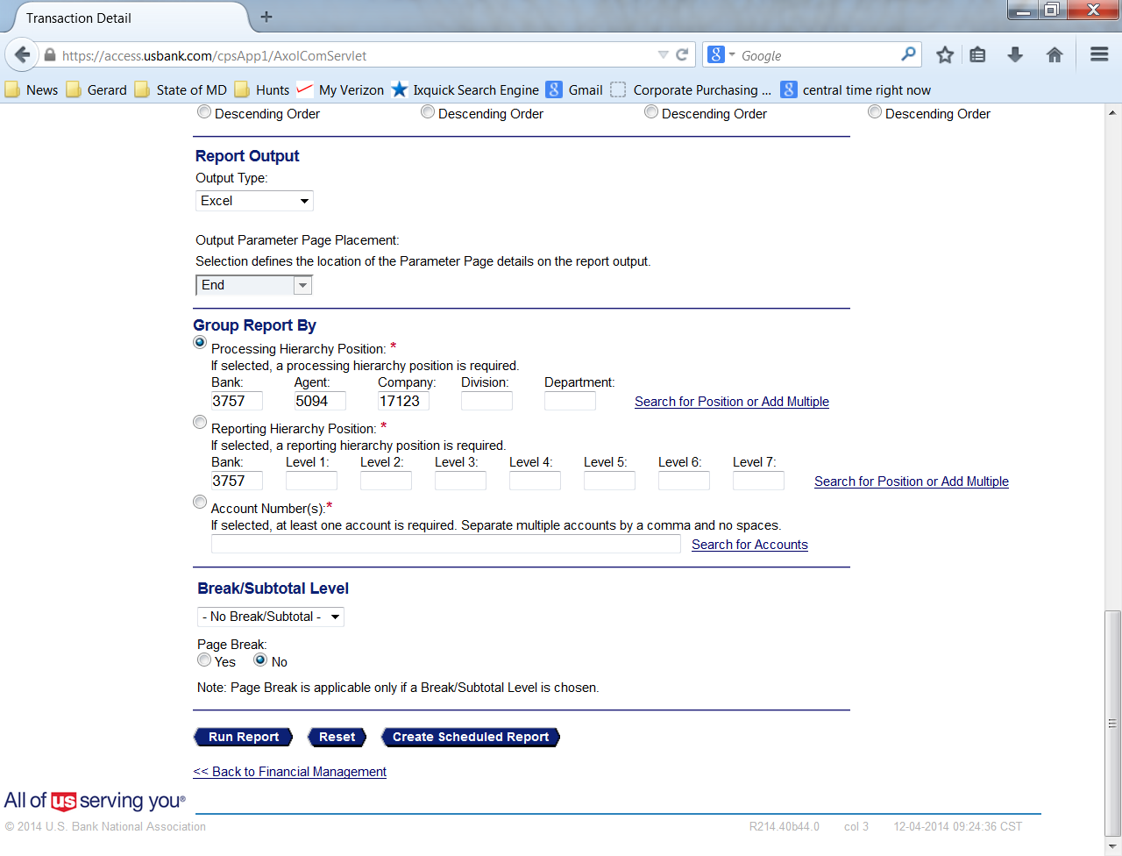
High Dollar Volume of Purchase by One Cardholder from an Obscure Vendor Transaction Detail Report
Enter Agent and Company number
Select Run Report

Slide 48
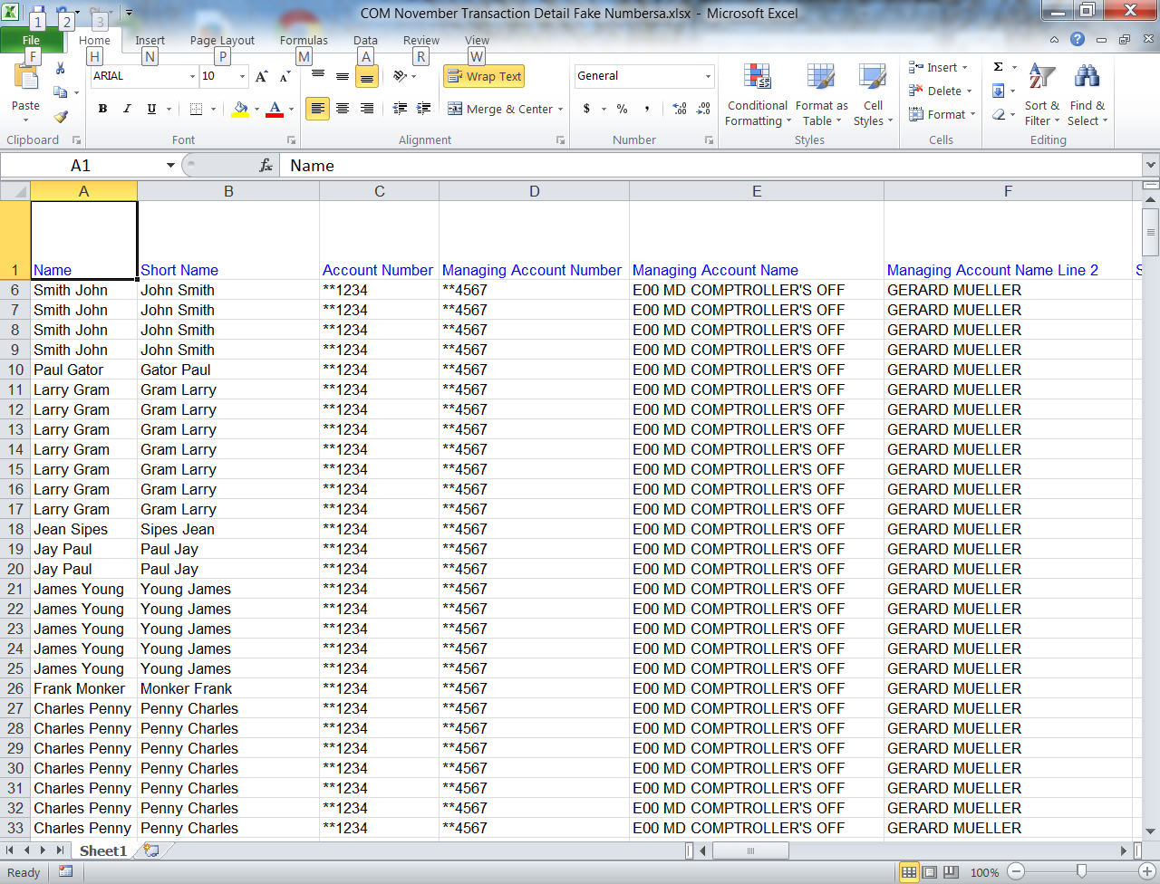
High Dollar Volume of Purchase by One Cardholder from an Obscure Vendor Transaction Detail Report
Save the spreadsheet to your hard drive

Slide 49
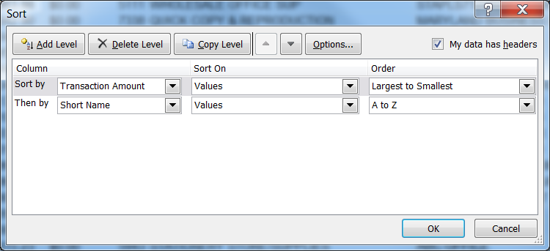
High Dollar Volume of Purchase by One Cardholder from an Obscure Vendor Transaction Detail Report
Sort Transaction amount Largest to Smallest, then by cardholder
Hide extra columns

Slide 50
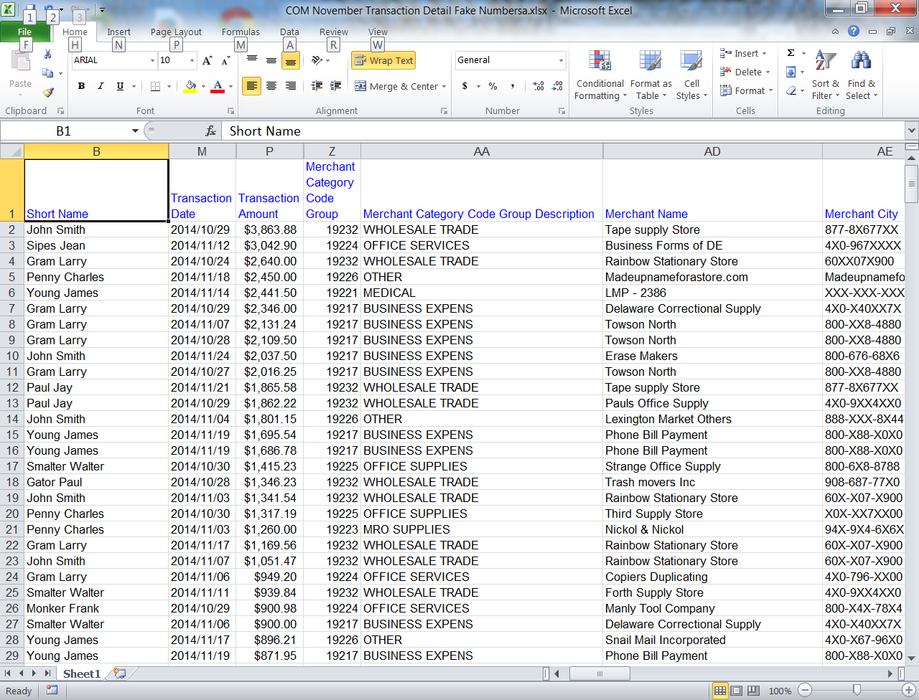
High Dollar Volume of Purchase by One Cardholder from an Obscure Vendor Transaction Detail Report
Review for obscure merchants

Slide 51
High Dollar Volume of Purchase by One Cardholder from an Obscure Vendor Transaction Detail Report
Any obscure vendor needs to be investigated
Ask the cardholder for additional information
Research the vendor on Department of Assessment and Taxation Website to determine if registered to do business in MD or Secretary of State if outside of MD
Google the company to determine legitimacy

Slide 52
Purchases Structured to Avoid Transactions Limits (Split Purchases)
Transaction Detail Report

Slide 53
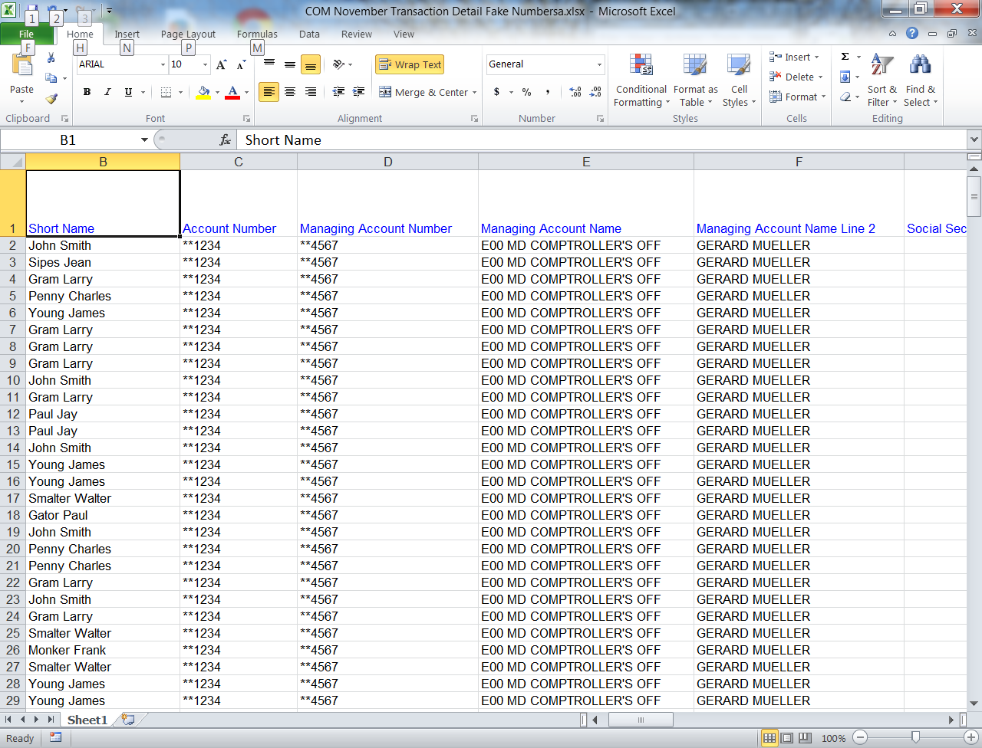
Purchases Structured to Avoid Transactions Limits (Split Purchases)
Select the Transaction Detailed Report previously used

Slide 54
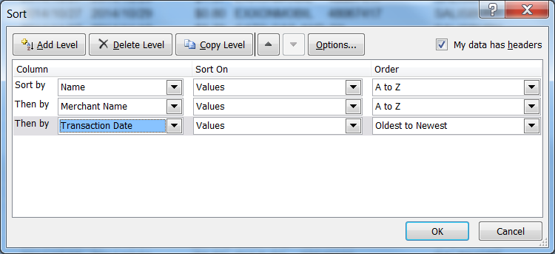
Purchases Structured to Avoid Transactions Limits (Split Purchases)
Scroll right hide unnecessary columns
Sort by Name, Merchant Name, Transaction Date
Notes:
Scroll right hide unnecessary columns
Sort by (Cardholder)Name,
Merchant Name,
Transaction Date

Slide 55
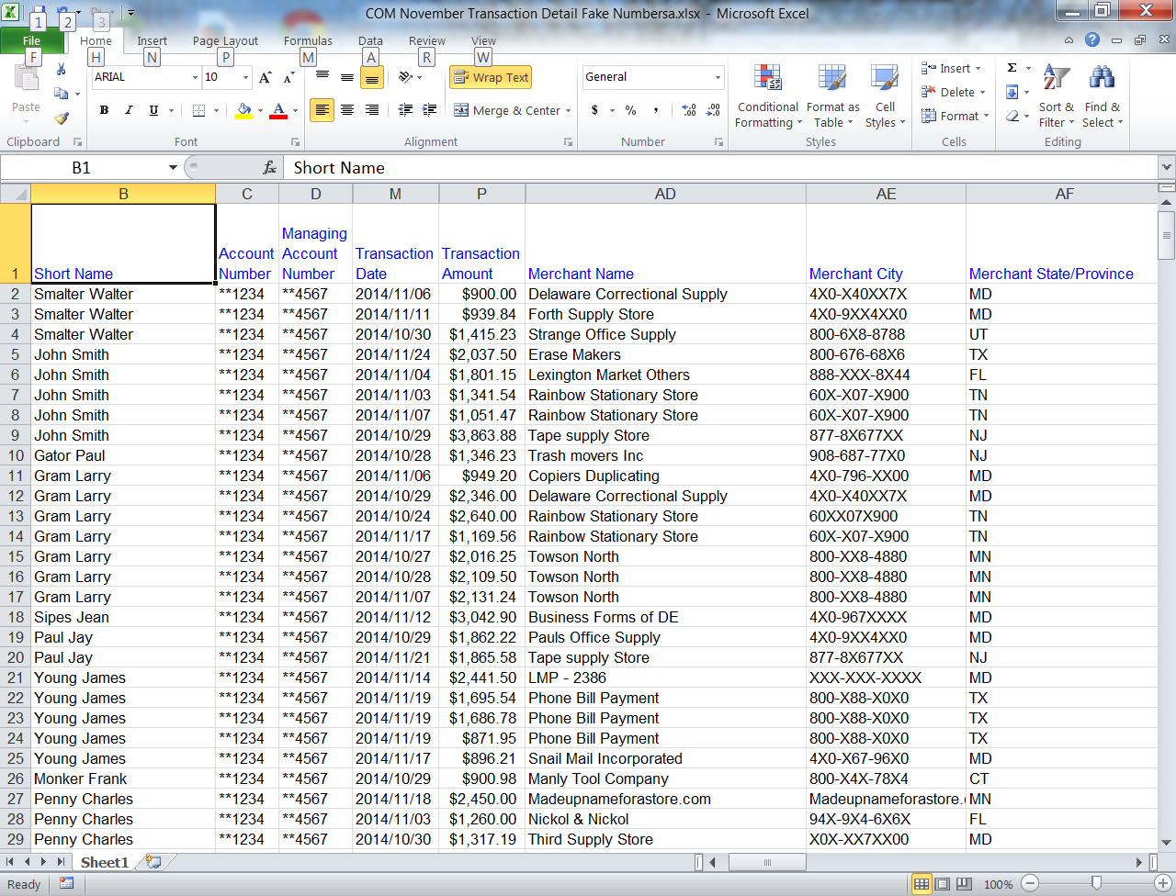
Purchases Structured to Avoid Transactions Limits (Split Purchases)
Look for same vendor with transaction amounts at or near the Cardholder’s SPL
Notes:
Look for same vendor with transaction amounts at or near the Cardholder’s Single
Purchase Limit
Cardholders like these who work for the Motor Fuel Testing lab are okay

Slide 56
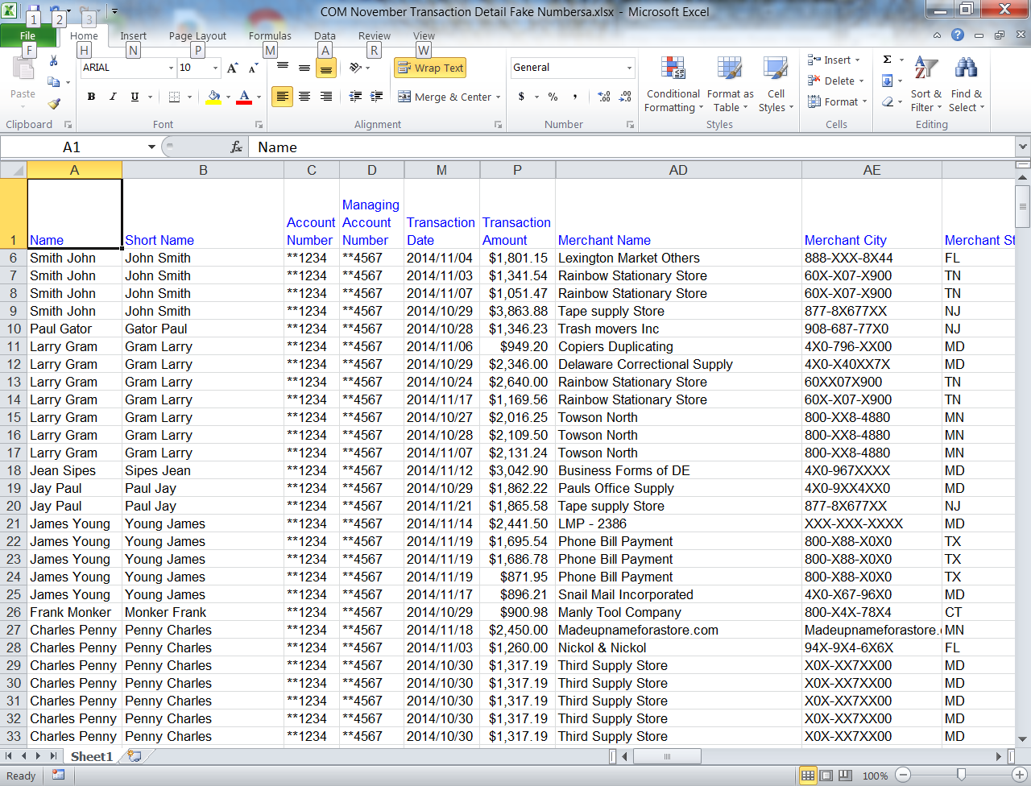
Purchases Structured to Avoid Transactions Limits (Split Purchases)
These transactions should be reviewed
Notes:
I added that transaction data to the spreadsheet. Tom did not make those transactions.

Slide 57
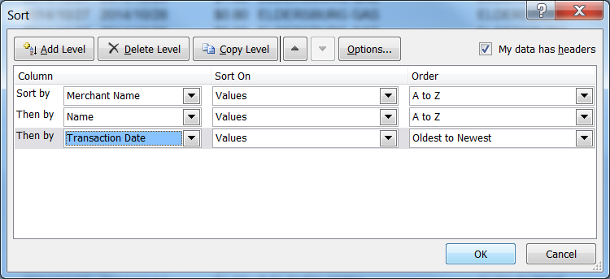
Purchases Structured to Avoid Transactions Limits (Split Purchases)
Also check if multiple cardholders are involved
Notes:
Taking a look at this same data
Resort by Merchant name
(cardholder) name
Transaction date

Slide 58
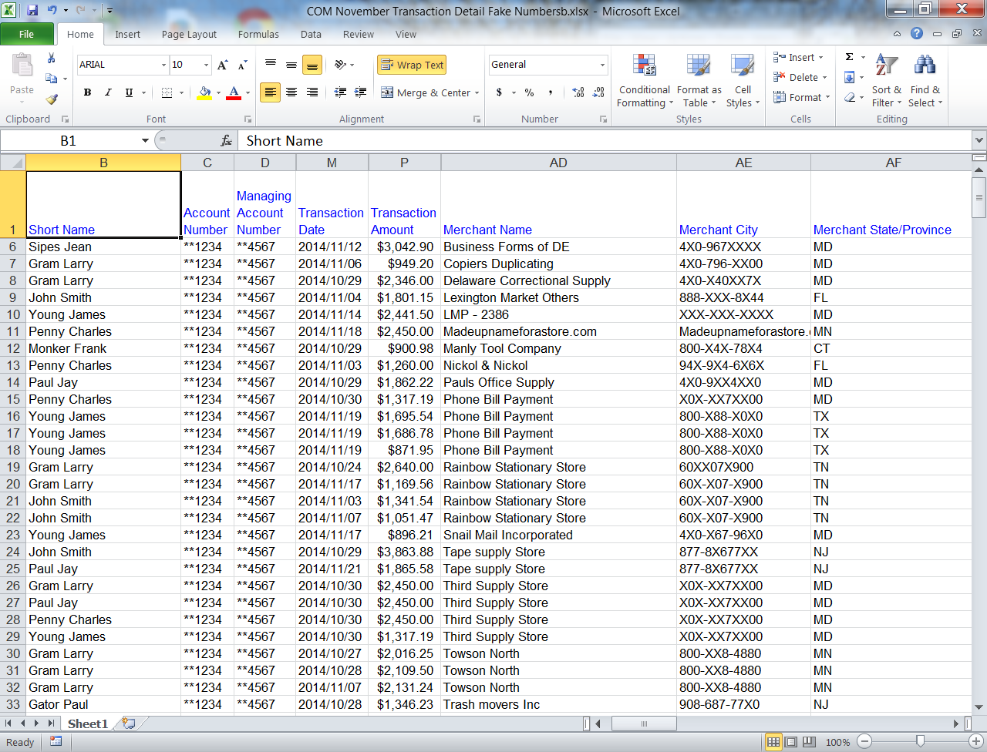
Purchases Structured to Avoid Transactions Limits (Split Purchases)
Here is an example made up for training
Notes:
Again I made these transactions up for today’s training to show an example of multiple cardholders participating in a split purchase.

Slide 59
Purchases Structured to Avoid Transactions Limits (Split Purchases)
Remember that you will get some false positives
Five people attending a conference that stay in the same hotel (each room is a separate transaction)
Getting parts to repair a vehicle (SHA), but when the mechanic tears down the engine and finds that additional parts are needed
Look for when a large ticket item is split
Notes:
Getting parts to repair a vehicle (SHA), but when the mechanic tears down the engine and finds that additional parts are worn of broken and needs to be replaced. But the amounts should be smaller than someone trying to split a large purchase to get around a Single Purchase limit.

Slide 60
Recommended Practices
These enhanced techniques are in addition to your monthly CPC reviews.
Ensuring compliance with the CPC Program Policy and Procedures Manual, COMAR And Procurement rules
Purchases “Further the Business of the State”
No gift cards or other cash like items
Reviewers and Managers practice due diligence in their reviews and approval
Cards and Account numbers are secured at all times
Problems are reported timely

Slide 61
Contact Information
Corporate Purchasing Card Staff
Gerard Mueller, 410-260-7520 gmueller@comp.state.md.us
Guy Brashears, 410-260-7458
gbrashears@comp.state.md.us
Assistant Director for GAD
Sandra Zinck, 410-260-7820
szinck@comp.state.md.us

